Slide 1
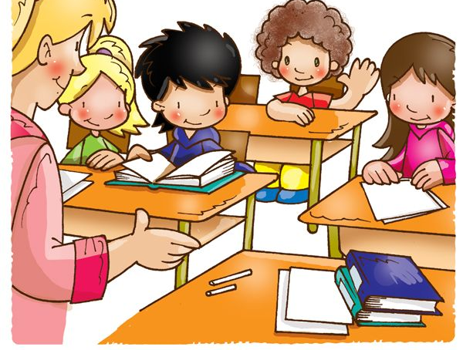
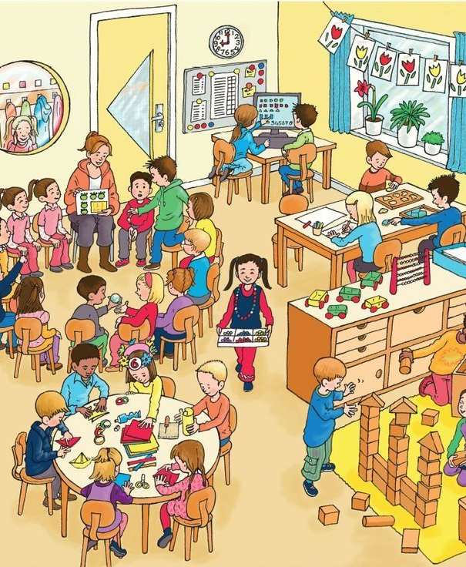
Unit 2: Our new things
Grade 3
Lesson Two: Grammar

Slide 2
Hello everyone!

Slide 3
Review:
Divide the class into 2 teams: Blue and Green. Clues for words will be shown and the team raises their hands first will get the chance to answer.
If the answer is correct, they can move their car forward 1 step,
if the answer is wrong, their car moves backward 1 step.
Continue until one team reaches the finish line, that team will be the winner!

Slide 4
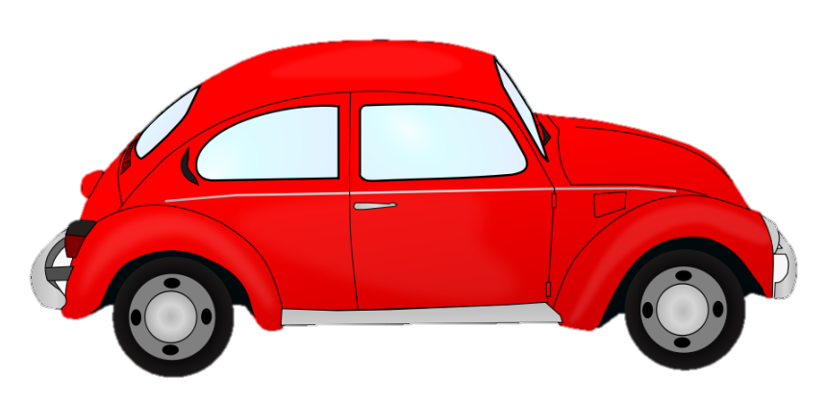
Team Blue
Team Green

Slide 5
Word 1:
A school supply. Stores things.
Answer
Pencil case
To the race

Slide 6
A tool can be used for many things. Runs by electricity.
Word 2:
Answer
Computer
To the race

Slide 7
Word 3:
An object made by hard materials like wood, plastic, glass,... There are a lot of them in the classrooms.
Answer
Table
To the race

Slide 8
An object used for hanging up coats.
Word 4:
Answer
Coat hook
To the race

Slide 9
A necessary object in classes. Used to write on.
Word 5:
Answer
Board
To the race

Slide 10
Word 3
Word 1
Word 4
Word 2
Word 5
NEXT!

Slide 11
Stoty

Slide 12
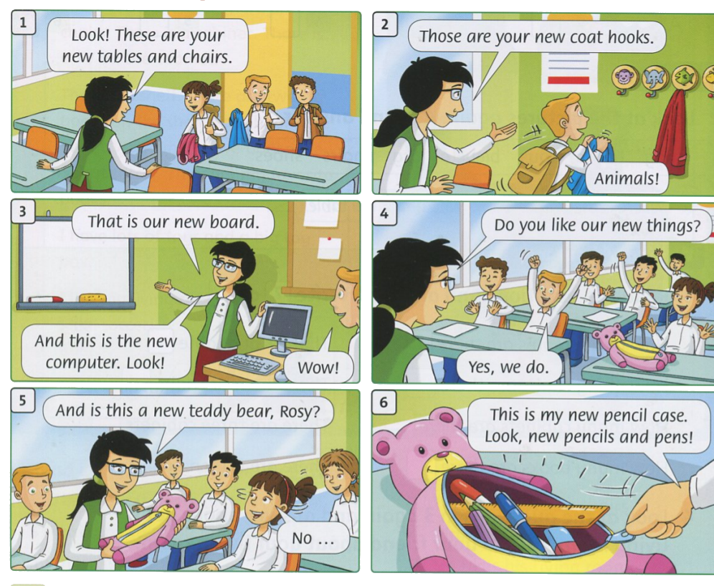
Listen to the story and repeat

Slide 13
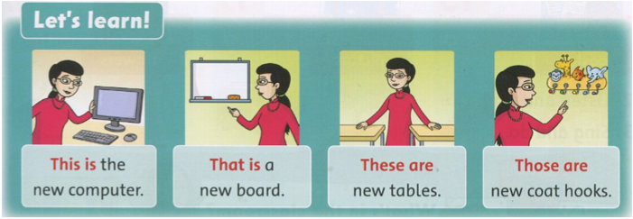
Listen and say

Slide 14
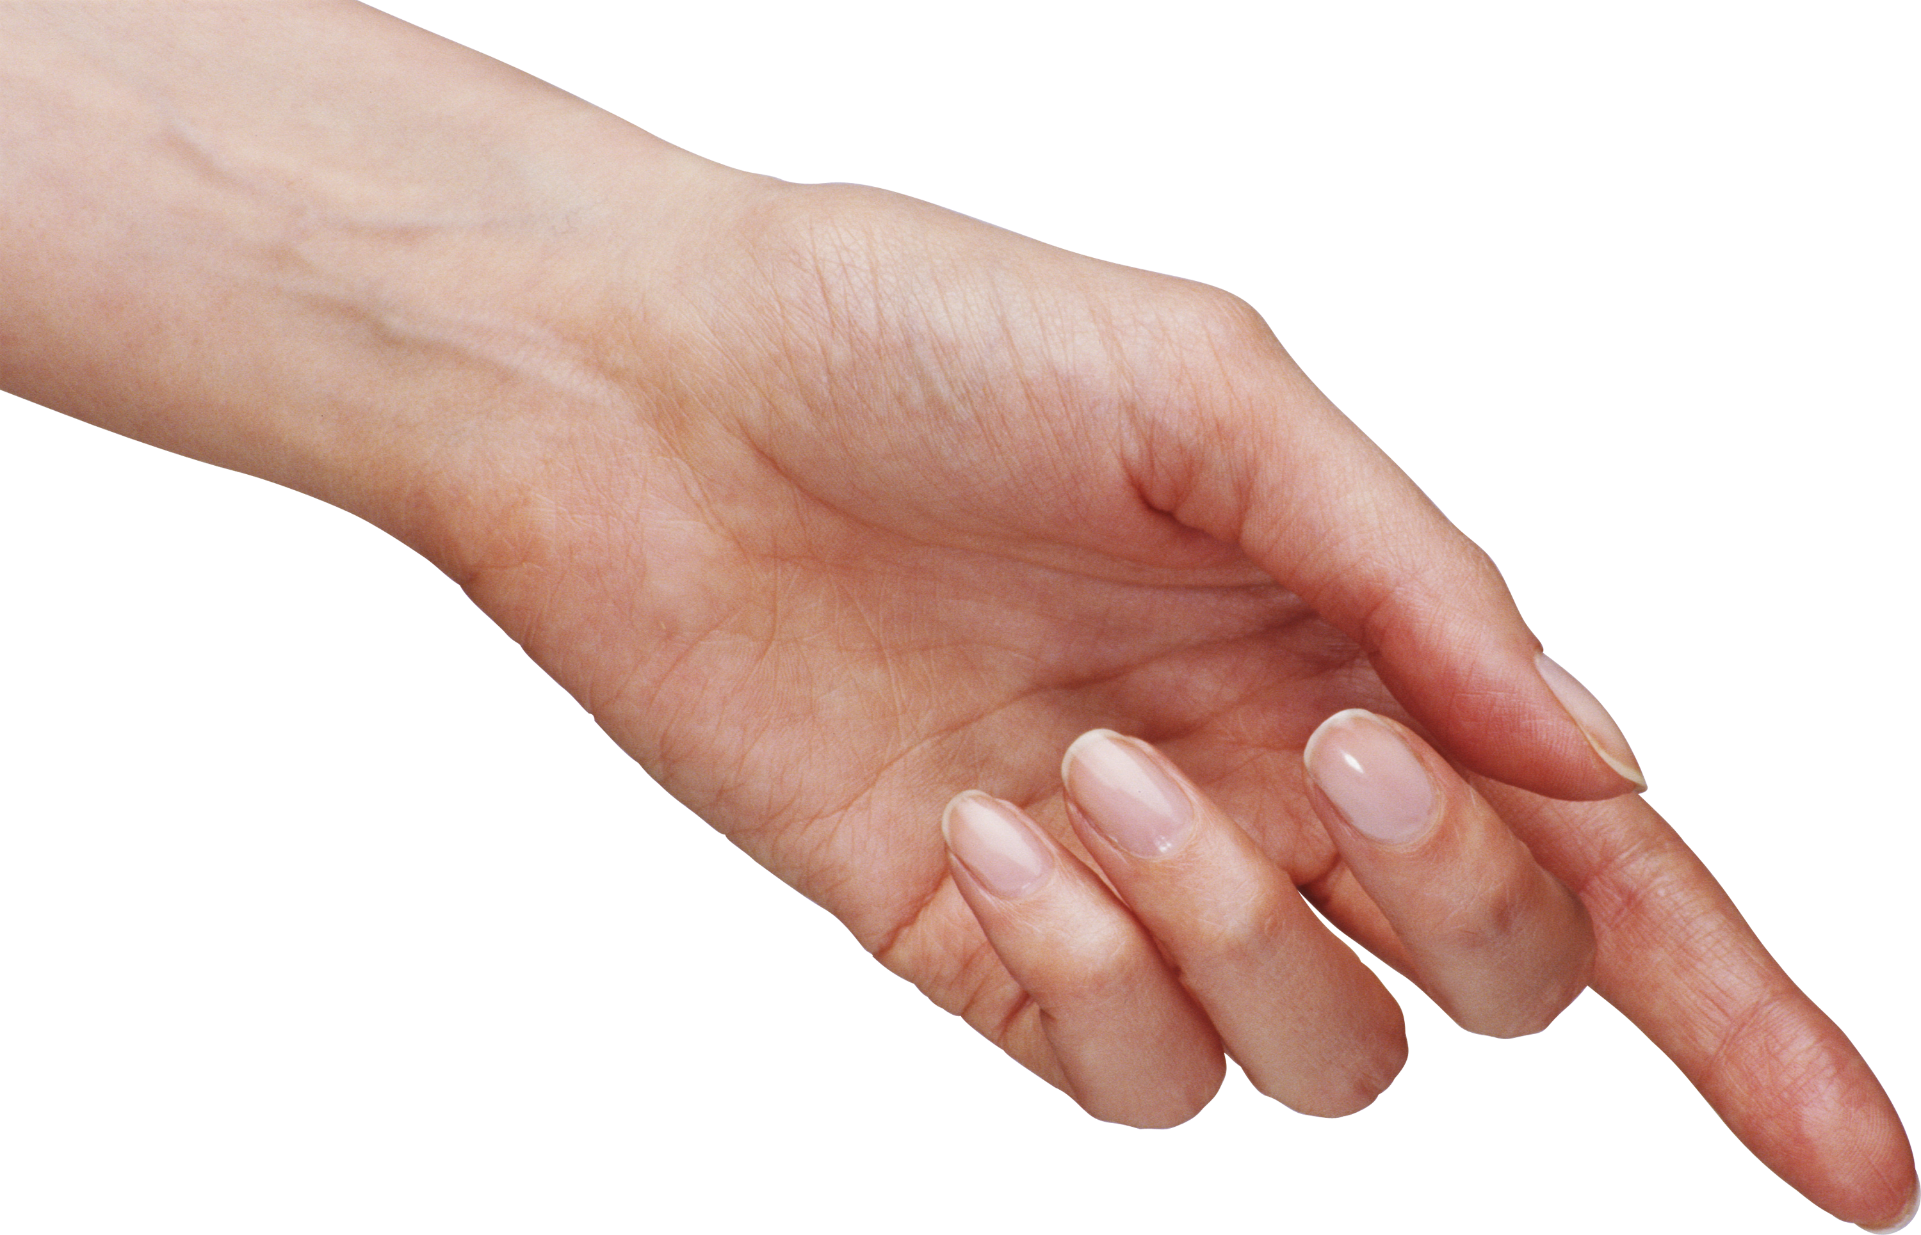
This is
a computer.
These are
computers.

Slide 15
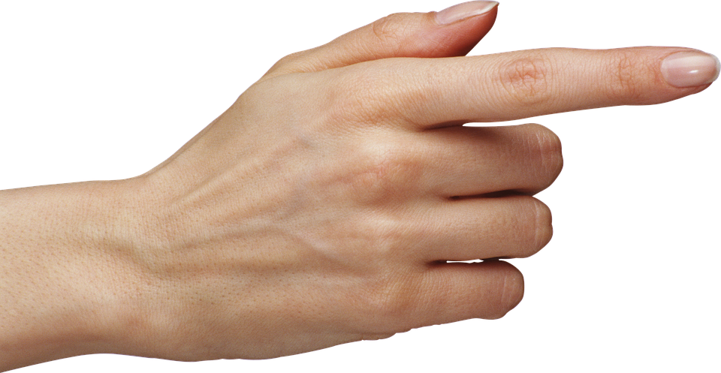
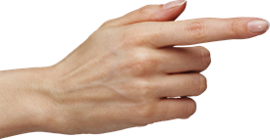
That is
a coat hook.
Th
Those are
coat hooks.

Slide 16
Look and say
Look around your classroom. Point and say!
Example:

Slide 17
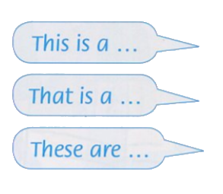
What you can use:

Slide 18
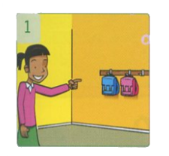
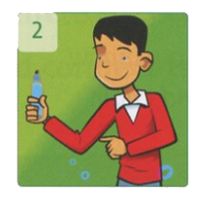
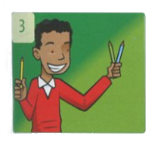
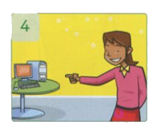
Now it’s your turn!
Exercises:
Review and write!
Answer
Example:
1.
Those
are bags.
2.
3.
4.
This
is a pen.
are pencils.
is a computer.
These
That

Slide 19
Tasks: Worktime!
Finish the works in your workbook!

Slide 20
Goodbye~!

